Slide 1
BELMONT PRIMARY SCHOOL..
BYOD and iPAD
PARENT INFORMATION NIGHT

Slide 2
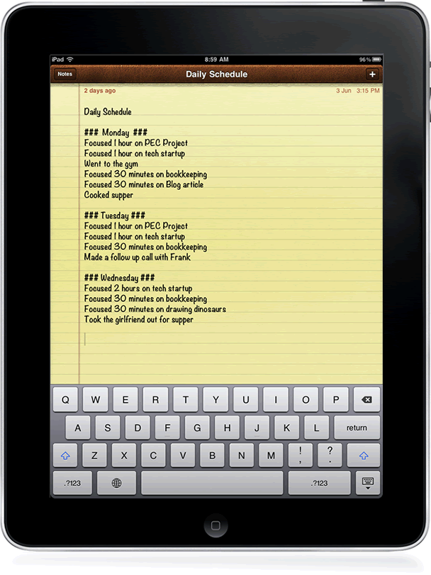
Tonight’s Format
1. Staff and student learning connections
2. Whole School Acceptable User Agreement
3. Student iPad User Agreement: Student responsibilities at school and home
4. School Support
5. Helpful Hints: Hints for at home and for setting up your iPad
6. Connecting to the school network
7. App list and information for BYOD students
8. Addressing your pre-submitted questions
9. Student learning and reflections

Slide 3
Staff and Student Learning Connections
The Grade 3-6 staff have been so excited to have successfully implemented a BYOD iPad program for the past 6 years. We have been extremely impressed with the care that students have taken to ensure that all iPads are safe and secure. We have been so proud of the students’ efforts here and adhering to the Belmont Primary School iPad Agreement document and school expectations.

Slide 4
Staff and Student Learning Connections
Staff have attended many professional development sessions and visited other iPad schools over the past six years. We have gained valuable knowledge and skills from these experiences which have been able to transfer into our planning and teaching, in order to align with the Digital Technologies strands of the Victorian Curriculum.
A great deal of work has been done at a whole school level around Cyber Safety and the importance of understanding how to safely use devices. Cyber Safety will continue to be a major focus in 2022.

Slide 5
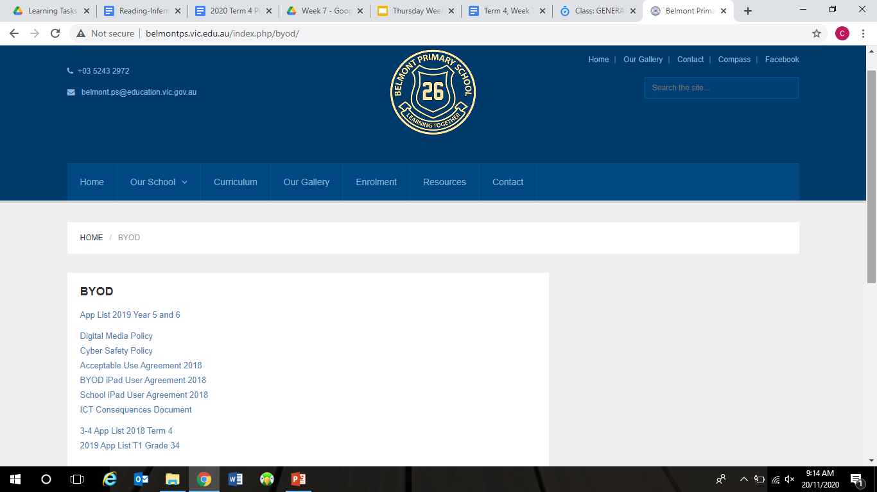
Agreements, Documents, and Policies
Belmont Primary School have developed a number of agreements, documents, and policies that help ensure the safe and responsible use of all digital technologies. All of these will be available on our school website before the end of term. This documents are currently been updated for the beginning of 2022.
Acceptable User Agreement
iPad User Agreement
Consequences Document
Cyber Safety Policy
Digital Media Policy

Slide 6
Agreements, Documents, and Policies
It is important to note that the following Agreements, Documents and Policies will continue to be modified over time, as the program further develops.
Teaching staff will work carefully with their students to ensure that students have a sound understanding of the expectations and requirements of iPad security, safety and usage.

Slide 7
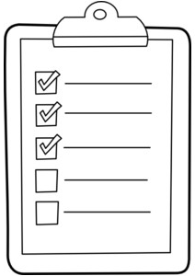
Whole School Acceptable User Agreement
In 2022, all students in Grades 3-6 must sign an Acceptable User Agreement.
This document promotes safe and responsible behaviour across all year levels.
The agreement covers three categories
- Communicating respectfully and sending polite messages;
- Protecting our personal information; and
- Looking after ourselves and others.
In addition to this agreement, Grades 3-6 students will be asked to sign an iPad Acceptable User Agreement.

Slide 8
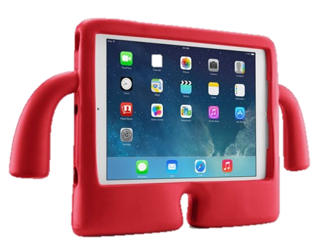
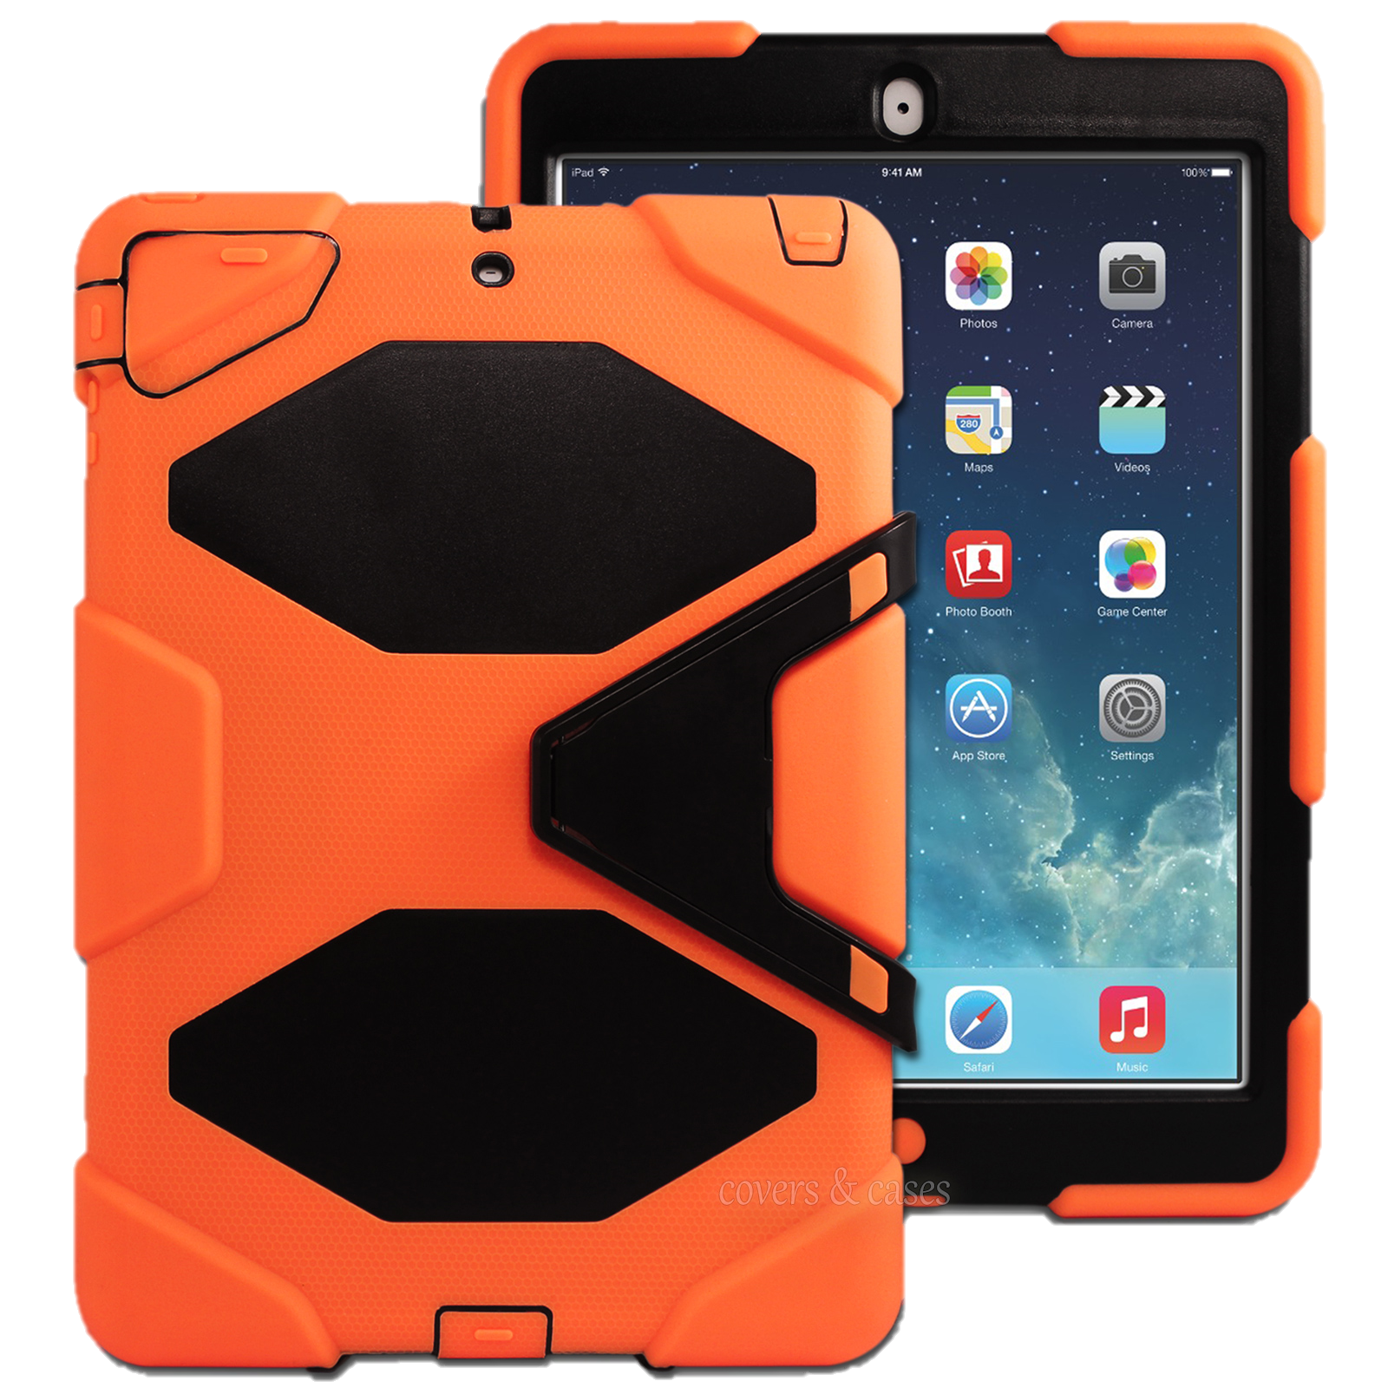
Student iPad User Agreement Student responsibilities at school and at home
The iPad is to be used as a tool to assist with student learning. It is therefore expected that the device will be maintained in accordance with our school policies and agreements.
There are two Student Agreements for the Grade 3-6 iPad Program; one for those who are bringing their own device (BYOD), and one for those using the school devices.
All grades 3-6 students will receive a current iPad User Agreement document at the beginning of each school year. It is important that all students read and sign the Student User Agreement document with their parents/guardians before taking part in the program in early Term 1, 2022.

Slide 9
BYOD iPad User Agreement Student responsibilities at school
A reminder that these agreements are available on the school website if you are interested in looking at these before Term 1, 2022. ☺
The student is responsible for:
1.1 Ensuring that the iPad has a screen protector and strong protective cover that remains on the iPad at all times.
1.2 Ensuring that their headphones remain at school in their table locker. If a student is using a school device, they must still supply their own headphones.
1.3 Bringing the iPad to school each day with at least 60% battery life.
1.4 Ensuring that their device and cover are clearly labelled with their name.
1.5 Bringing their school bag containing their iPad into the classroom from 8.45am every day.

Slide 10
BYOD iPad User Agreement Student responsibilities at school
1.6 Keeping the iPad secure when not in use during the school day by placing it in the classroom’s lockable storage cabinet.
1.7 Ensuring that their iPad is packed carefully into their bag before leaving school each day.
1.8 Always using the iPad responsibly both at school and at home, in accordance with the school rules. This includes:
Using the iPads at school as a learning tool. This means only using appropriate and relevant apps for the learning activity as directed by the teacher.
Not touching anyone else’s iPad unless asked to do so by a teacher, this includes not sharing their iPad with other students.
Ensuring that all communication on the iPad is respectful at all times.

Slide 11
BYOD iPad User Agreement Student responsibilities at school
1.8 continued…
Not communicating with others through their iPad when at school (unless asked to do so by a teacher as part of a learning activity). This includes Airplay and Airdrop features.
Ensuring that any photos or videos taken of students and teachers are not published online, unless approved by a teacher.
Not revealing personal information about themselves or others online using their iPad in anyway, including email addresses, surnames, phone numbers or passwords.
Alerting a teacher or parent/carer immediately to any inappropriate content or communications on their iPad.
Ensuring that all content is appropriate to have at school (eg; apps, music, videos etc.)
Ensuring that any account created on the iPad (that is approved by a teacher or parent) is used in an appropriate way.

Slide 12
BYOD iPad User Agreement Student responsibilities at school
1.9 Following appropriate safety and care procedures as outlined by the classroom teachers, including:
Handling the iPad carefully, and taking care with the placement of the device at all times.
Handling their school bag carefully and ensuring that the iPad remains in their school bag when moving to and from school.
When moving with the iPad, ensuring that it is held securely with both hands and is not in use.
Ensuring that the iPad protective cover and screen protector are left on the device at all times.
Taking care when packing the iPad into the schoolbags and not placing it underneath heavy items.
Ensuring that food and drinks are kept well away from the iPad at all times.
Ensuring that nothing is put on the iPad that is inappropriate or offensive (eg; content or stickers etc.)

Slide 13
BYOD iPad User Agreement Student responsibilities at school
1.10 Backing up data securely at home, if desired.
1.11 Ensuring that the App Store is not accessed at school without teacher direction.
1.12 Ensuring that there is enough working storage (minimum 2GB) on the iPad to be able to complete activities each day.
1.13 Ensuring that no file sharing or copyright infringement software or material is stored on the iPad.
Where a student does not fulfil these responsibilities the school will use the Belmont Primary School Consequences for Inappropriate Behaviour Document in deciding the most appropriate consequence or response. (You will find this document on our school website).

Slide 14
BYOD iPad User Agreement Responsibilities at home
Here are some important details for parents/guardians to help support their child with the responsibility of their iPad at home: (outlined in the Student iPad User Agreement Section 2)
2.1 Ensuring that the student brings their iPad to school each day.
2.2 Ensuring that the iPad is protected with a strong quality cover and screen protector.
2.3 Ensuring that the iPad provided is kept up to date with the latest Operating System available.

Slide 15
BYOD iPad User Agreement Responsibilities at home
2.4 Ensuring that the iPad is securely backed up at home, if desired.
2.5 Ensuring that the required apps are downloaded and available to be used.
2.6 Ensuring that all content on the iPad is appropriate for the student to have at school (eg; apps, music, videos etc.)
Notes:
hfirhtufremvgklrjgio

Slide 16
School Support
All teachers will continue to guide and support students in all areas of learning.
All classrooms have lockable storage for the iPad to be stored in when students are not in the classroom throughout the day.
All students will participate in thorough and explicit class sessions that regard the safety and appropriate use of personal and school devices at the beginning of the year and throughout. This will be a major priority in Grades 3-6.

Slide 17
School Support
Cyber Safety will continue to be a high priority across all year levels. Throughout 2022, the Grade 3/4 area will undertake tasks from the Australian Government’s ‘CLASS ACT 50’ Cyber Safety challenge.
Students will also have input into developing classroom expectations to help consolidate their understanding of safety and appropriate use.
Any disputes regarding damage or loss that has occurred at school will be mediated by the school Principal, on a case-by-case basis.

Slide 18
Helpful Hints at Home
Treat the iPad like any new learning experience. Just like riding a bike, your child will need guidance and support and undoubtedly they will make mistakes. Help them and encourage them through this process, this is how they will learn!
Reinforce the importance of looking after the device.
Notes:
hfirhtufremvgklrjgio

Slide 19
Helpful Hints at Home
Have a morning routine and an afternoon routine. Go through this with your child. For example;
The iPad gets packed into the bag straight after tea or before breakfast;
Have a set time and location for charging the iPad;
Have a designated area for iPad use;
Check the school bag each morning to ensure that the iPad is packed.
Supervising the student’s iPad and internet use at home to ensure that the student is using the iPad safely and responsibly.
Encourage your child to show you what they are doing, what app they are using, and what content they are accessing.
Notes:
hfirhtufremvgklrjgio

Slide 20
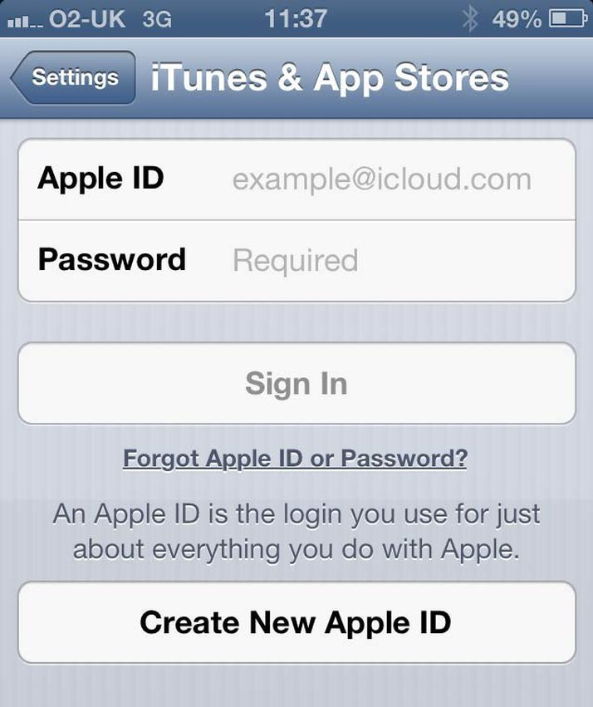
Helpful Hints For Setting Up your iPad
Setting up an Apple ID or an account:
To set up your iPad you will need an Apple ID. Your Apple ID is an account linked to an email account (of your choice), this account enables you to download apps from the App Store and allows you to back up to ‘The Cloud’.
Being aware that if your child knows the Apple ID password for the account on their iPad, it is possible for them to purchase apps or other content without permission.
All other accounts for student use will be administered by the school (this will allow students to login to certain apps).
Notes:
hfirhtufremvgklrjgio

Slide 21
Helpful Hints For Setting Up your iPad
Passcodes:
A passcode lock for your home screen is optional. If you decide to have one, your child must know the code. We recommend for students to have a passcode for security reasons. If you would like teachers to have a copy of the passcode, that is also your decision.
Internet access:
If you do not have reliable internet access at home, free internet is available at various locations like local libraries and some cafes.
Notes:
hfirhtufremvgklrjgio

Slide 22
Helpful Hints For Setting Up your iPad
App Organisation:
It is preferable that all school-based apps are placed onto the first home screen to allow easy access to these when at school.
Setting up folders: A suggestion is to set up folders for any home content or apps. Students will be learning how to organise school-based apps into folders during class sessions.
At times, we may ask you to download a specific app as required throughout the term. For example, an app relating to a special event or occasion.
Notes:
hfirhtufremvgklrjgio

Slide 23
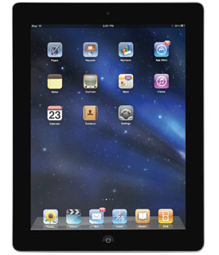
Connecting to the School Network
Students need to be connected to the school network.
They will need to bring their iPad to school to be connected and to have a school security certificate installed. This certificate will allow safe access to the internet.
For those students who do not have their devices yet, this process will occur in the first week of Term 1, 2022.
Notes:
hfirhtufremvgklrjgio

Slide 24
Connecting to the School Network
To ensure an effective start to the program, all students who are new to the program and are bringing their own device to school will need to connect to our school server (Grade 3s and new students to Belmont).
OPTIONAL EARLY CONNECTION FOR THOSE WHO ALREADY HAVE iPADS
When: We will be beginning this process on Monday the 13th of December for those students who already have their devices (the last week of school). This will mean that these students are automatically connected to our school network for the beginning of 2022.
Where: Your child will need to take their iPad to 3/4C’s classroom between 8.45 and 9.00am and leave the device with Mr Corker. When not in use, your child’s iPad will be stored in the school security room. The device can be collected from 3/4C’s classroom at the end of the school day.
Please sign-up for your child to bring their iPad to school and connect to the school server, if you would like to do this. ☺

Slide 25
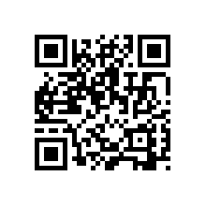
App list and information for BYOD students
Please refer to your ‘App List’ handout.
Over the past 6 years, we have explored many apps that support a range of learning tasks and curriculum areas. To date, all of the apps we have required have been free apps. In 2022, we will be introducing some apps that require payment.
More details will be provided about these apps next year.

Slide 26
Addressing your pre-submitted questions
Q: Are the devices going to be covered by school insurance whilst on school property?
No, devices are not covered by the Department of Education Insurance. You will need to check that your home insurance covers the device. Property that the school does not own is not covered, including staff personal devices etc.
Q. What if my child’s iPad is damaged at school?
Whilst the iPad cannot be covered by school insurance, the school will examine carefully any such occurrence and support families where appropriate. Q. Does the school do software maintenance (viruses etc.) and install firewalls so that inappropriate content cannot be searched or downloaded?
Students are directed by the teacher to use specific apps and websites. When completing an internet search (which also occurs under teacher direction) the Department of Education filtering system restricts access to inappropriate sites and content.

Slide 27
Addressing your pre-submitted questions
Q. How are students storing their iPads at school?
Devices will be stored in the class lockable storage cabinet.
Q. Do students need a passcode to lock their iPads?
Optional, but recommended.
Q. Can we provide an older model iPad for our child?
We are happy for families to provide an older model iPad, however we are finding that certain models are no longer supported by iOS system updates and many of the apps that we use. We recommend a Gen 7,8 or 9 iPad.

Slide 28
Addressing your pre-submitted questions
Q. Is an iPad mini okay?
Yes, absolutely.
Q. What are the minimum requirements for the device?
This really depends on how much you and your child are planning on storing on the device. We require a minimum of 2G of free space for school use. We have found iPads with 32G and above to be ideal, but it is fine if you already have a device with less storage.
Q Why are BPS stipulating use of iPad versus Android devices?
There are a few reasons for this. Apps on an android devise often look and perform different to those of an Apple App. We have found historically this has caused issues for both the student and staff. We are also set up for iPad use at BPS.
If you have any further questions, please come and chat to one of us at the end of this session ☺

